Slide 1
Ashwini T - 152984 Training Room 4 Capgemini MIPL Chennai

Slide 2
CAPSTORE APPLICATION

Slide 3
Modules Assigned
Email Services

Slide 4

Email Service:
For verification and promotion purpose, the email service acts as the communication platform.
Admins and Merchants can use the service to contact each other or the user.
Tables to be interacted are merchant, admin, customer and email.
Click to insert section title
Notes:
O Logo de espadas deve ter mais espaço das pontas abaixo. Sugerir outros tipos de imagens/ telefone, fones.

Slide 5

Tables used
Customer
Merchant
Admin
Customer Id
Name
Phone Number
Email Id
DOB
Password
Is Active
Last Login
Merchant Id
Name
Company Name
Email Id
Password
Status
Phone Number
Is Active
Is Certified
Admin Id
Email
Password
Last login
Notes:
Otimo.
Mas eles acham que talvez a forma verde va conflitar se eles mudarem o logo espada para cima do lado direito.

Slide 6
Tables :
Customer Table
Column Name | Data type | Constraint | Description
customerId | int | Primary key Auto Generated | Used for unique identification
customerName | varchar | NotNull
phoneNumber | int | NotNull
emailId | varchar | unique | Will be Used for user Login
Dob | Date | NotNull
Password | Varchar | NotNull | Authentication purposes
Address | varchar | Foreign Key
Status | Varchar | NotNull | To let know if user is active or not
Notes:
Fixar a posicao do titulo – sempre do lado esquerdo.
Sempre que tiver muito texto o coluna deve sempre ser “ narrowed” , se nao fica dificil de ler. Colocar paragrafos no texto.
Linha vertical deve ser mais fina e as pontas NUNCA devem ser arredondadas.

Slide 7
Merchant Table
Column Name | Data type | Constraint | Description
merchantId | int | Primary key Auto Generated | Used for unique identification
merchantName | varchar | NotNull
phoneNumber | int | NotNull
emailId | varchar | unique | Will be Used for merchant Login
companyName | varchar | NotNull
Password | Varchar | NotNull | Authentication purposes
Address | varchar | Foreign Key
Status | Varchar | NotNull | To let know if user is active or not
isCertified | Boolean | NotNull | Is the Merchant CapStore Certified or Not
isValidated | Boolean | NotNull | Is the Merchant CapStore validated by admin or not
Notes:
Fixar a posicao do titulo – sempre do lado esquerdo.
Sempre que tiver muito texto o coluna deve sempre ser “ narrowed” , se nao fica dificil de ler. Colocar paragrafos no texto.
Linha vertical deve ser mais fina e as pontas NUNCA devem ser arredondadas.

Slide 8
Admin Table
Column Name | Data type | Constraint | Description
Admin Id | int | Primary key Auto Generated | Used for unique identification
emailId | varchar | unique | Will be Used for admin Login
Password | Varchar | NotNull | Authentication purposes
Last Login | Date | NotNull | last login date
Notes:
Fixar a posicao do titulo – sempre do lado esquerdo.
Sempre que tiver muito texto o coluna deve sempre ser “ narrowed” , se nao fica dificil de ler. Colocar paragrafos no texto.
Linha vertical deve ser mais fina e as pontas NUNCA devem ser arredondadas.

Slide 9
Email Table
Column Name | Data type | Constraint | Description
Id | int | Primary key Auto Generated | Used for unique identification
From | varchar | unique | Used to send and receive Mail.
To | varchar | NotNull | Used to send and receive Mail.
Subject | varchar | NotNull | Subject of the Mail
Body | varchar | NotNull | Body of the Mail
Date | date | Dd-mm-yyyy | Date at which a mail is sent
Notes:
Fixar a posicao do titulo – sempre do lado esquerdo.
Sempre que tiver muito texto o coluna deve sempre ser “ narrowed” , se nao fica dificil de ler. Colocar paragrafos no texto.
Linha vertical deve ser mais fina e as pontas NUNCA devem ser arredondadas.

Slide 10
Customer and Merchant
01
Customer email Id ,Merchant email Id used to receive mail from Admin.
Admin
Admin email Id is used to send a mail to Customer and Merchant.
02
Email
Mail contains following fields,
From
To
Subject
Body
Date
03
www.referencia.com
© 2017 Capgemini. All rights reserved.
10
Notes:
Este slide eles acham que esta muito apertado.
Mudar o estilo do texto do lado esquerdo para diferencia-lo do texto do lado direito. Menos texto e mais impactante “short introduction”. Coloccar este texto do lado esquerdo da mesma cor da forma e o fundo do dlide claro.

Slide 11
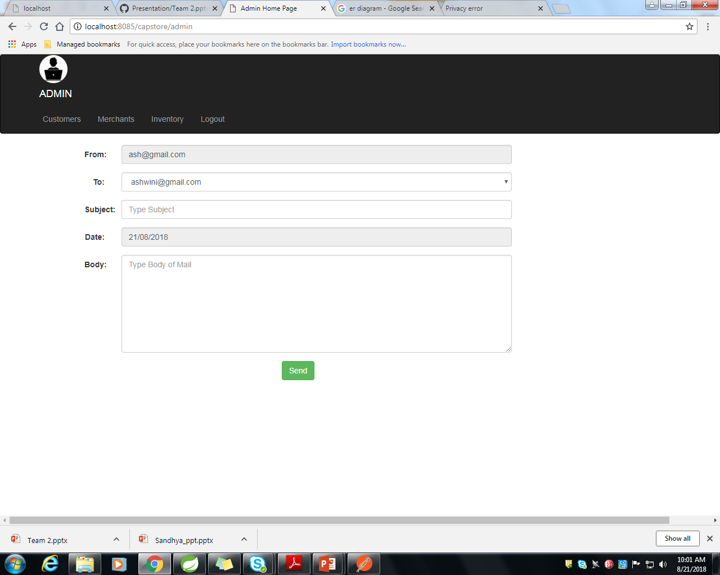
Compose Page
From
Admin email address. It is automatically fetched from admin table. It is disable field.
List of email address available in dropdown box. It is automatically fetched from customer table.
To
Subject
Subject of Mail. For Example, Discount available.
Body
Body of the Mail. For Example, 10% Discount available to this product.
Date
Current date is fetched automatically. It is displayed in required format. It is disable field.

Slide 12
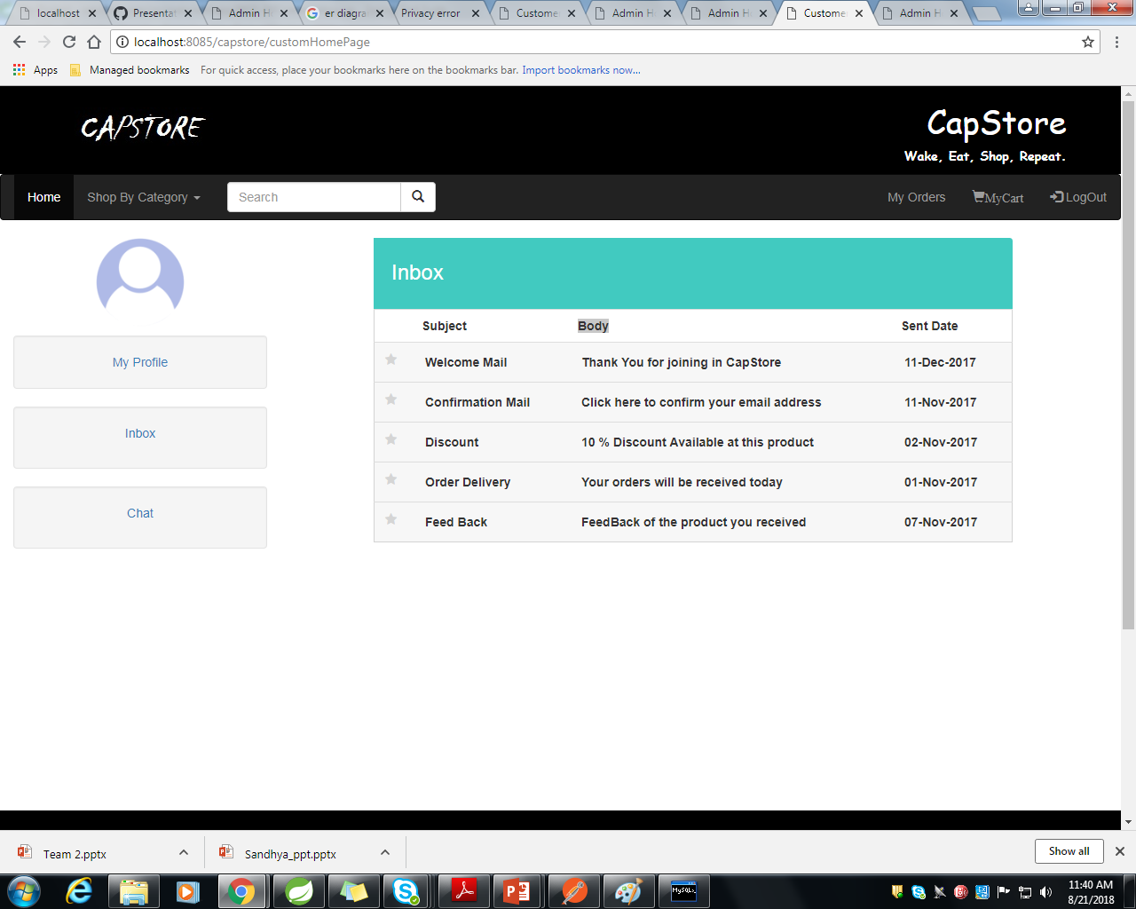
Inbox Page
Subject
It is fetched from email table.
Body
It is fetched from email table.
Sent Date
It is fetched from email table.

Slide 13
Output Screenshot
Inbox page

Slide 14
Output Screenshot
Compose page

Slide 15
THANK YOU

